Slide 1


Slide 2
SQL Server high availability and disaster recovery

Slide 3


Sponsor

Slide 4

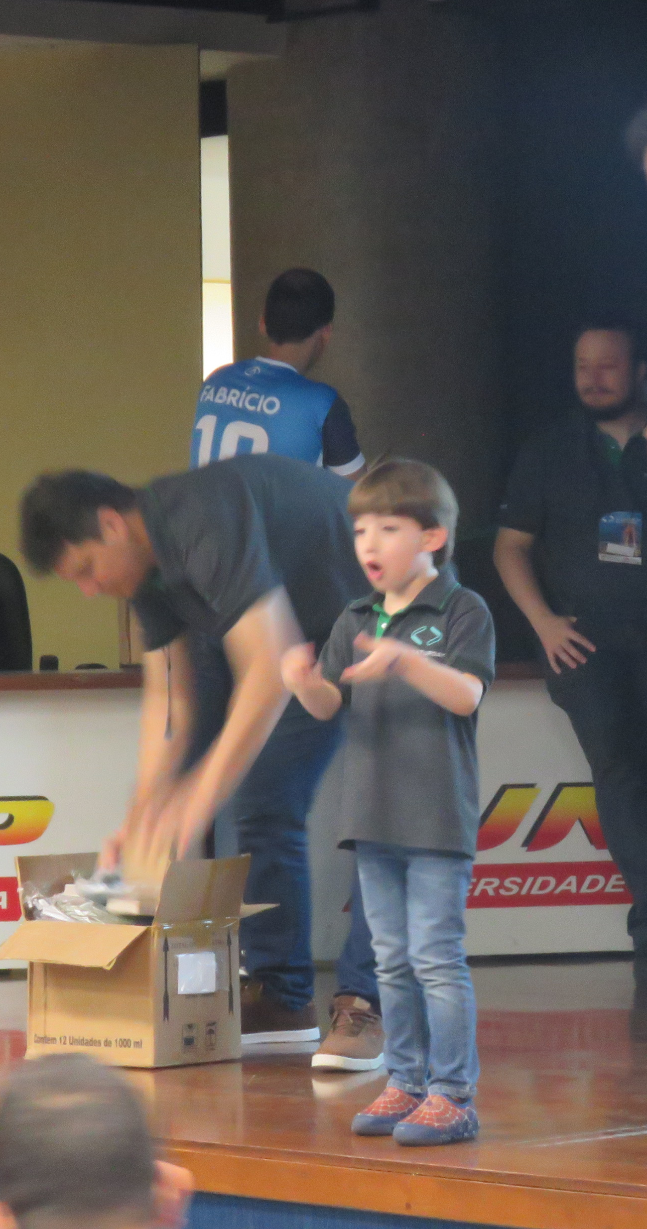

Roberto Fonseca
Data Platform MVP since 2015
MCT – Microsoft Certified Professional
SQL Saturday SP Organizer
Senior Database Administrator @Pythian
Happy husband and dad
rffonseca@outlook.com
https://www.linkedin.com/in/rffonseca

Slide 5
Agenda
  Is Disaster Recovery and High Availability the same?
  Why Transaction Log is so important
  Be sure your backups are regularly taken and tested
  Log Shipping
  Database Mirror
  Failover Cluster
  AlwaysOn Availability Groups

Slide 6
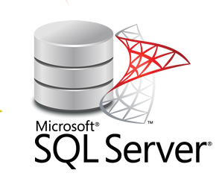


High Availability
  Failover solution in the event of a server/database fails
  Means uptime requirements
  Database available to users
Disaster Recovery
  Policies and Procedures to enable a recovery from disaster
  RPO and RTO
  Security
  Documentation
Notes:
HA means uptime requirements and if database is available to users. It means that in case of any outage, the service is handled by another node that takes action without any user noticing. Give some examples.
HA and DR should complement each other
HA is measured in 9s 99,999% is 5 minutes in a year, 99.99% is 52 minutes, 99.9% is 9 hours
DR means the ability to recover from disaster. Recovery Point Objective means how much data can be lost in case of a disaster. RPO must consider which data can be lost. Recovery Time Objective is the time the data can be unavailable in case of a disaster. RTO must be a sum of reinstalling, updates, restoring, rebuild and process any data.
RPO and RTO are strategic to calculate risks and ensure safety margins to recover systems and data. Clear and detailed plans must be in place to protect and recover systems after a disruptive event like a flood or fire
Main goal is recovery and continuity of businesses
If you only have one datacenter, it means that the best you can do it having backups stored outside the datacenter

Slide 7
Why Transaction Log is so important?
Every HA and DR uses Transaction Log to accomplish this goal
TL is critical to the health of a database
Critical to operation of HA and DR

Slide 8
ACID concept
It is a single logic unit of work
Atomic
Consistent
Isolated
Durable
Notes:
Atomic – It cannot be divided. It is a matter of COMMIT or ROLLBACK
Consistent – Data should be consistent before the transaction and must be consistent, following the rules, after the transaction finishes.
Isolated – Every transaction must be isolated from each other and do not affect any other transactions running at the same time
Durable – Transaction must be durable. Must survive after any outage or crash

Slide 9




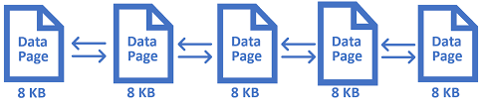

How ACID relates to TL?
BEGIN TRAN
UPDATE Clients SET Name = ‘John’
WHERE Id = 10
UPDATE Clients SET Name = ‘Peter’
WHERE Id = 5
COMMIT
BEGIN TRAN
UPDATE Clients SET Name = ‘John’
WHERE Id = 10
UPDATE Clients SET Name = ‘Peter’
WHERE Id = 5
COMMIT
Notes:
Atomic – It cannot be divided. It is a matter of COMMIT or ROLLBACK
Consistent – Data should be consistent before the transaction and must be consistent, following the rules, after the transaction finishes.
Isolated – Every transaction must be isolated from each other and do not affect any other transactions running at the same time
Durable – Transaction must be durable. Must survive after any outage or crash

Slide 10
Transaction Log
SQL Server continuously log all records to TL
When reaching the end of file, SQL will reuse log file starting from beginning
Protects the log records marking the portion of TL as ACTIVE
SQL Server releases internal log files (VLFs) when they are not needed anymore
In case of any reboot/crash, SQL Server will guarantee the consistency by REDO/UNDO phase
Log records might be marked as Active to support HA/DR features

Slide 11
Disaster Recovery
The best way to guarantee a good Disaster Recovery is a consistent Backup Plan

Slide 12
Database Recovery Model
Simple Recovery Model
Support to a crash recovery
Log records will be marked as inactive after the checkpoint
No LOG Backups
Data will be lost since the last Full/Diff Backup
Full Recovery Model
Log records will be marked as Inactive only after a Log Backup
Can be used to restore a database to a specific Point-in-Time or to a specific LSN
Data loss would the minimal
Bulk-logged Model
Small footprint for bulk load processes
Point-in-Time is not supported
Can be switched between Full and Bulk Log models

Slide 13
Features Available
Log Shipping
Windows Failover Cluster
Database Mirroring
AlwaysOn Availability Groups
Replication

Slide 14
Important approaches
Use your preferred tool to run backups
Store it separated from the database server itself
Test your backups regularly
Have a monitoring process to guarantee the backups are regularly taken
Have a regular Audit process to ensure they meets your SLA

Slide 15
Logshipping
Feature uses Log Backups to a standby database in a secondary server
Can be used by any edition

Slide 16
Log Shipping
- Runs a Log copy and restore backup in a secondary server
Can be used as a warm secondary server
Must be brought online manually
Can be useful for large databases
Is easily configured

Slide 17
Windows Failover Clustering
Failover Cluster is a HA feature
Stable and easy to manage
Available since Windows NT 4.0
SQL Server Cluster is now called as AlwaysOn Failover Cluster Instance, but it runs on top of a Windows Server Failover Cluster
It is not the same as AlwaysOn Availability Groups

Slide 18
Windows Failover Clustering
Nodes are part of a Windows Failover Cluster
An Inactive Node takes ownership in case of any failure bringing database online
A Virtual Cluster Name is available to make it transparent to user applications
Servers should be as much identical as possible
Redundant hardware and shared storage
It is not a SQL Server feature only

Slide 19
Database Mirroring
Compatible with LogShipping and Windows Failover Cluster
Still popular in several customers
Completely separated SQL Server instances
Configured as High Safety (Sync) or High Performance (Async) modes
Witness server needed to automatic failover
Connection strings must have a FailoverPartner server name
Deprecated
AlwaysOn Availability Groups is the newest option to it

Slide 20
AlwaysOn Availability Groups
Multiple replicas
Listener
Cluster and Mirroring features altogether
Available since SQL Server 2012
Per database instead of Per Instance feature
SQL Server instances are independent
Backups on secondary

Slide 21
AlwaysOn Availability Groups
Object Synchronization
Database Level Health Protection
Read Only Load Balancing

Slide 22
Replication
Feature built to bring data closer to users
Based on Publisher and Subscribers
Articles instead of databases
Not a true HA or a DR feature, but can be used as well

Slide 23
Roberto Fonseca
Data Platform MVP since 2015
MCT – Microsoft Certified Professional
SQL Saturday Organizer
Senior Datatabase Administrator @Pythian
Happy husband and dad
rffonseca@outlook.com
https://www.linkedin.com/in/rffonseca

