Slide 2


Sound off.
The mic is all yours.
Influence the product roadmap.
Join the Fabric User Panel
Share your feedback directly with our Fabric product group and researchers.
https://aka.ms/JoinFabricUserPanel
Join the SQL User Panel
Influence our SQL roadmap and ensure it meets your real-life needs
https://aka.ms/JoinSQLUserPanel

Slide 4

SQL Server 2025 for DBAs
Marcelo Adade
Roberto Fonseca

Slide 5





sp_who2
Marcelo Adade
Microsoft Data Platform MVP
Principal database Engineer (SQL Server)
Database Consultant and Instructor at DBBITS (Sao Paulo)
SQL Saturday São Paulo - organizer
https://www.linkedin.com/in/marceloadade/
Roberto Fonseca
Microsoft Data Platform Senior Consultant at Pythian
Microsoft Data Platform MVP
Microsoft Certified Professional
SQL Saturday São Paulo - organizer
https://www.linkedin.com/in/rffonseca/
https://pythian.com/careers/
rffonseca@outlook.com

Slide 6
Agenda
SQL Server Evolution
New features on SQL Server 2025
Features that the DBA will enjoy! – (almost) no A.I.

Slide 7



SQL Server Evolution
From a on‑premises database to a hybrid data platform
Fully integrated with cloud and AI services
Automation-first DBA tooling
Performance optimization with intelligent features

Slide 8
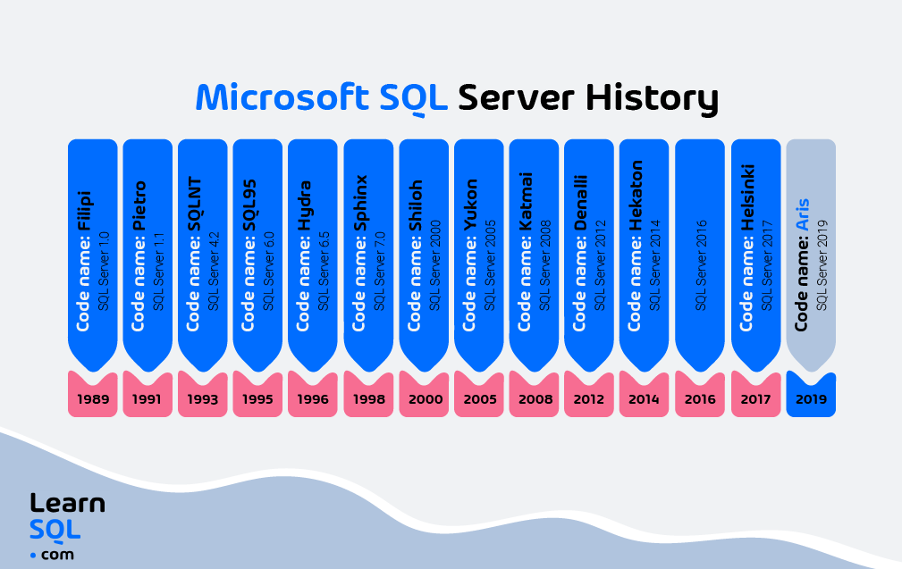
https://learnsql.com/blog/history-ms-sql-server/

Slide 9
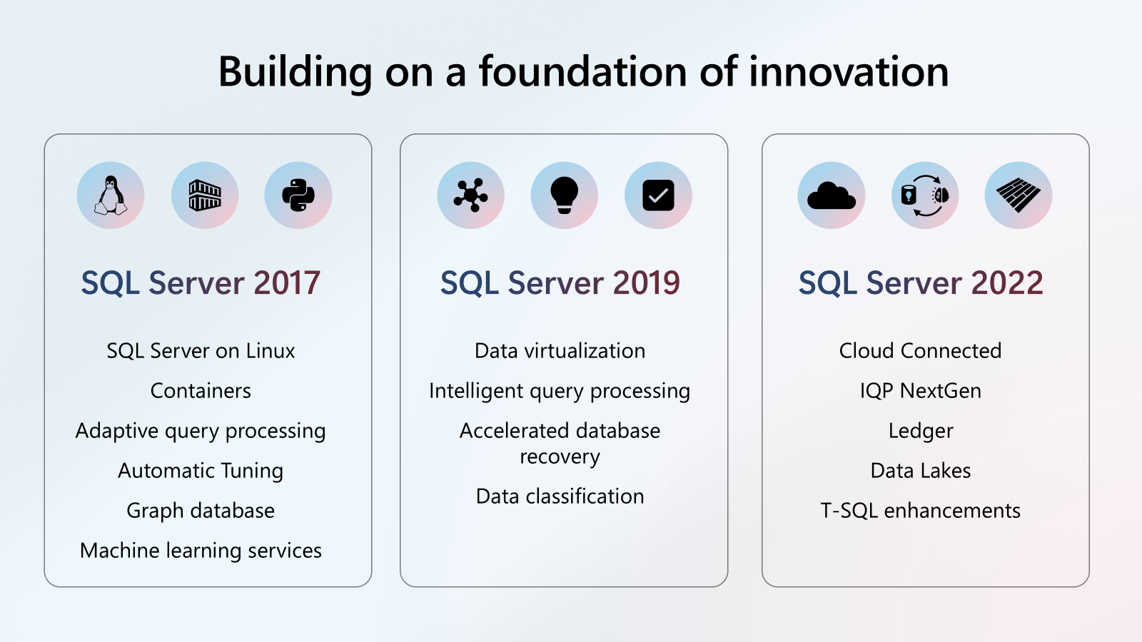
SQL Server Evolution

Slide 10
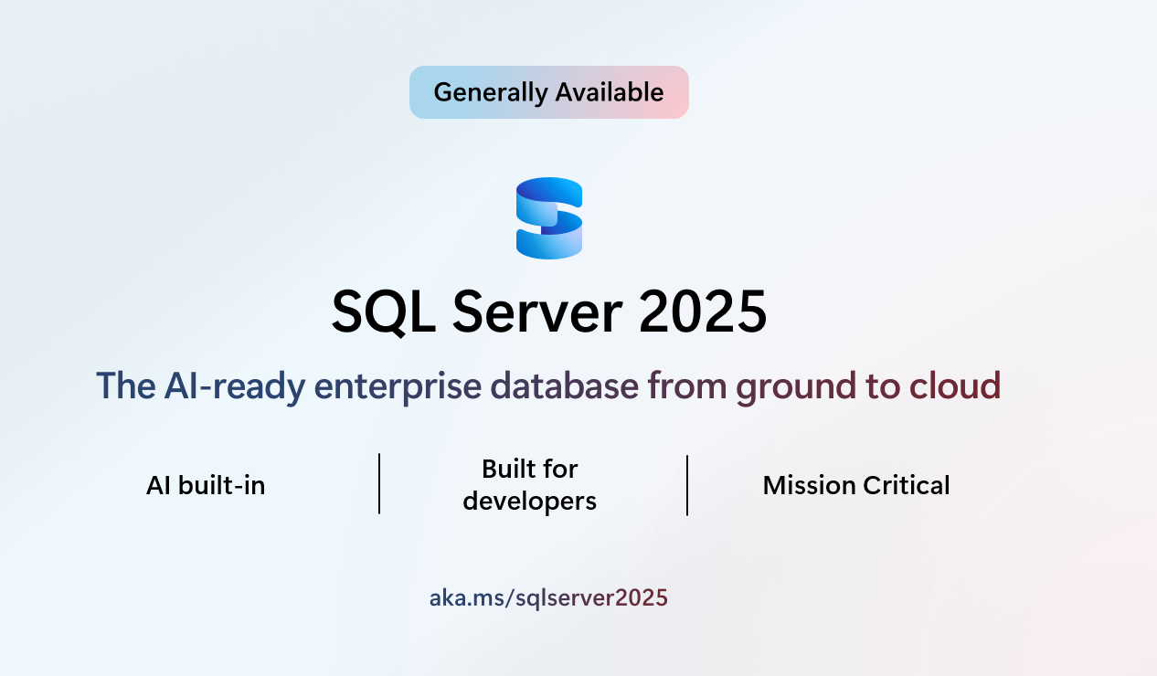
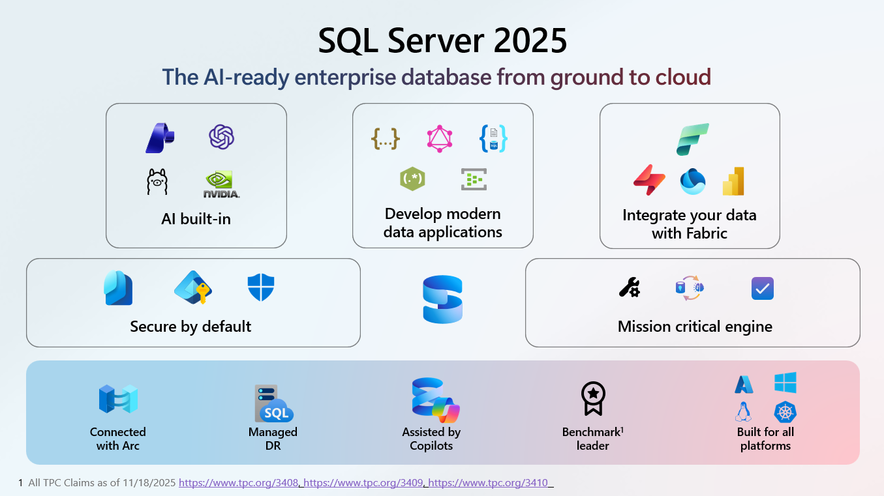
SQL Server Evolution

Slide 11
New features on SQL Server 2025 (1)
Standard edition increased capacity limits
Resource governor in Standard Edition
Increased capacity limits in Express edition
New developer editions
Github Copilot in SSMS
Vector data type
External model management
Change event streaming
Regular expressions
JSON functions
Notes:
Max database size went from 10 GB to 50 GB
LocalDB was a Express with Advanced Services feature

Slide 12
New features on SQL Server 2025 (2)
AG – allow db to switch to resolving state
AG – commit wait in milliseconds
DAG support for Contained AG
DAG sync improvements
Improved Health Check timeout diagnostic
TLS 1.3 encryption with TDS 8.0
Regular Backup on secondary replicas
Managed identity with Microsoft Entra
Optimized Locking
ADR in tempdb
Notes:
Max database size went from 10 GB to 50 GB
LocalDB was a Express with Advanced Services feature

Slide 13
New features on SQL Server 2025 (3)
Persisted stats in readable secondaries
ZSTD Backup compression algorithm
Adding CE feedback for expressions and Optional Parameter plan optimization in IQP set of features
DOP ON by default
Query store for Readable secondaries ON by default
ABORT_QUERY_EXECUTION hint
And more…
Notes:
Max database size went from 10 GB to 50 GB
LocalDB was a Express with Advanced Services feature

Slide 14

Enough A.I. talk

Slide 15
Features that DBAs will enjoy!
SSMS 22
Standard Edition
sp_invoke_external_rest_endpoint
Optimized Locking
AG full backup on secondaries
New algorithms for backup compression
Query store on secondary replicas
ABORT_QUERY_EXECUTION

Slide 16

Basics
Brand new SSMS 22 – GA – Current Version 22.4.1
SQL Server Management Studio | Microsoft Learn
Uses Visual Studio Installer. No more MSI installation
Works with SQL Server 2014 and later versions
Optional Language Packs
Modern, updated connection dialog
AI assistance – copilot Github (Preview)
Query Hint (Preview)
Compatibility Level – 100 – 170 (default)
New SQL Server Standard Developer Edition
SQL Server Express Edition max database size to 50GB
Editions and Supported Features of SQL Server 2025 - SQL Server | Microsoft Learn
Notes:
Max database size went from 10 GB to 50 GB
LocalDB was a Express with Advanced Services feature

Slide 17
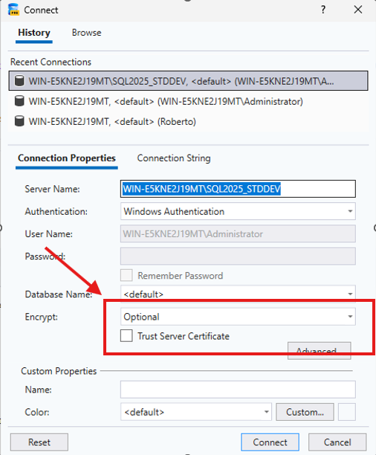
Basics – SSMS 22
Modern, updated connection dialog
Notes:
Hint to Encrypt dialog

Slide 18
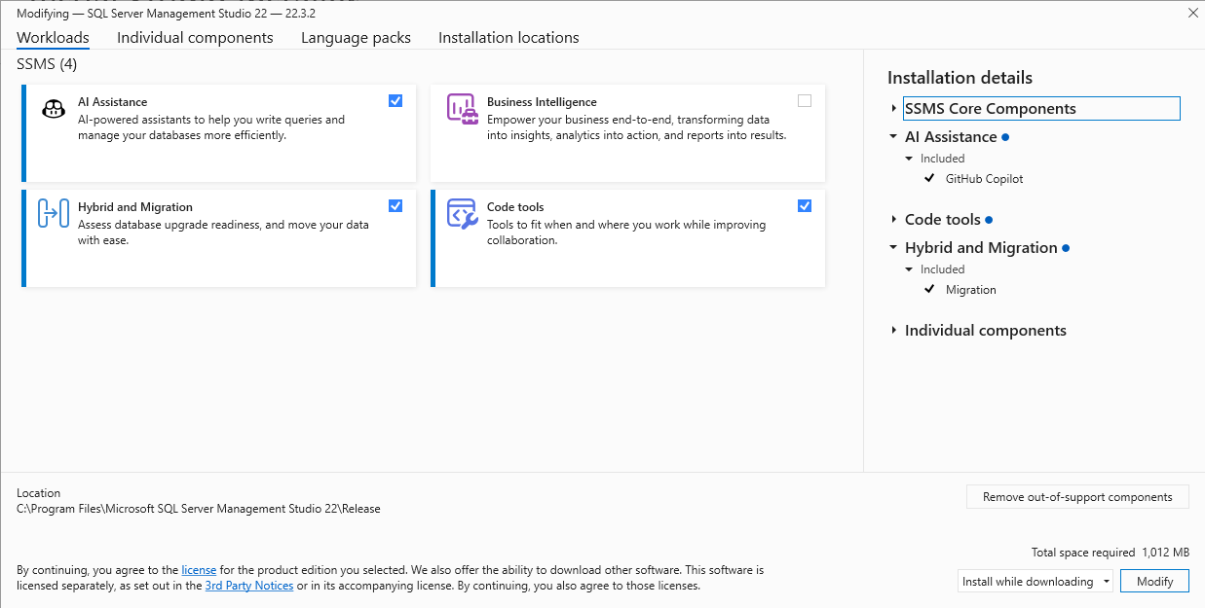
Basics – SSMS 22
Github Copilot
AI Assistance
Query Hint Recommendation tool
DMA is retired (since July 16, 2025)
New themes
JSON Viewer
Fabric Integration
Zoom on results grid
Notes:
Alternatives to DMA
SQL Server Migration Component in SQL Server Management Studio (SSMS).
Azure Database Migration Service (DMS) for seamless migration to Azure SQL.
Azure Migrate for wide discovery and SQL assessment at scale.
Azure SQL Migration Extension in Azure Data Studio for smaller workloads.
SQL Server enabled by Azure Arc for continuous weekly assessments.

Slide 19
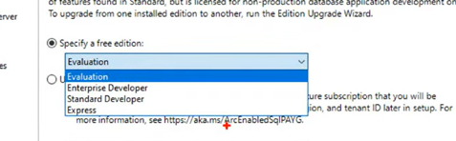
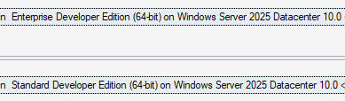
SQL Server 2025
New SQL Server Standard Developer Edition (along with Enterprise Developer Edition)
  Two new editions with full feature set from their respective production editions
  Licensed only for development and testing
Notes:
Alternatives to DMA
SQL Server Migration Component in SQL Server Management Studio (SSMS).
Azure Database Migration Service (DMS) for seamless migration to Azure SQL.
Azure Migrate for wide discovery and SQL assessment at scale.
Azure SQL Migration Extension in Azure Data Studio for smaller workloads.
SQL Server enabled by Azure Arc for continuous weekly assessments.

Slide 20
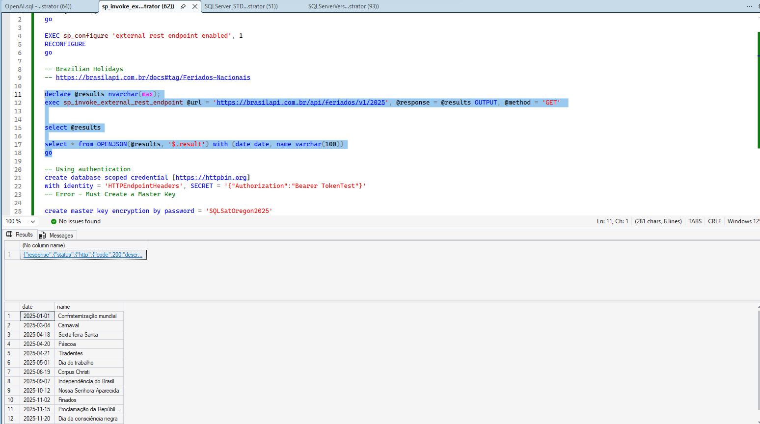
REST API: sp_invoke_external_rest_endpoint
  Data processed via an Azure Function
  Update a PowerBI dashboard
  Call a local REST endpoint
  Talk to Azure OpenAI Services

Slide 21
Optimized Locking
  Improved transaction locking mechanism to reduce lock blocking and lock memory consumption for concurrent transactions
  Based on two main components
    Transaction ID (TID)
    Locking After Qualification (LAQ)
  Accelerated Database Recovery (ADR)
Notes:
A transaction ID (TID) is a unique identifier of a transaction. Each row is labeled with the last TID that modified it. Instead of potentially many key or row identifier locks, a single lock on the TID is used to protect all modified rows. For more information, see Transaction ID (TID) locking.
Lock after qualification (LAQ) is an optimization that evaluates query predicates using the latest committed version of the row without acquiring a lock, thus improving concurrency. LAQ requires read committed snapshot isolation (RCSI). For more information, see Lock after qualification (LAQ).

Slide 22
Why Optimized Locking
    Excessive Blocking
    Memory utilization
    Long running locking
    Lock escalation
Notes:
A transaction ID (TID) is a unique identifier of a transaction. Each row is labeled with the last TID that modified it. Instead of potentially many key or row identifier locks, a single lock on the TID is used to protect all modified rows. For more information, see Transaction ID (TID) locking.
Lock after qualification (LAQ) is an optimization that evaluates query predicates using the latest committed version of the row without acquiring a lock, thus improving concurrency. LAQ requires read committed snapshot isolation (RCSI). For more information, see Lock after qualification (LAQ).

Slide 23
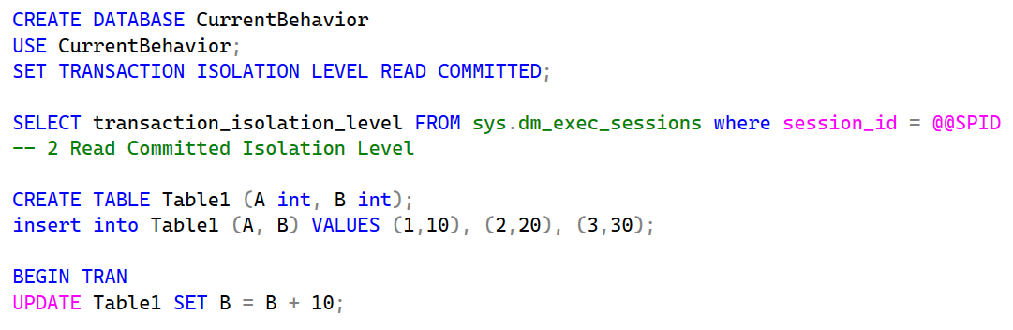



Current Behavior
Table1
Page 1
Lock Manager
Lock Mode | Lock Type | Resource
IX | Object | Table1
IX | Page | Page1
X | RID | Row 1
X | RID | Row 2
X | RID | Row 3
 | A | B
Row 1 | 1 | 10
Row 2 | 2 | 20
Row 3 | 3 | 30
Notes:
Update may require thousands or million Exclusive Locks to finish the transaction
With Optimized locking, SQL will still lock thousands or million rows, horwver, each lock will be released as soon as each row is updated

Slide 24
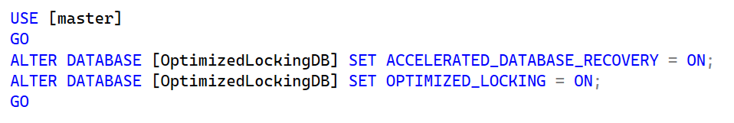
How to Enable
    Enabled by default on Azure Database
    DBAs should evaluate on your environment
Notes:
A transaction ID (TID) is a unique identifier of a transaction. Each row is labeled with the last TID that modified it. Instead of potentially many key or row identifier locks, a single lock on the TID is used to protect all modified rows. For more information, see Transaction ID (TID) locking.
Lock after qualification (LAQ) is an optimization that evaluates query predicates using the latest committed version of the row without acquiring a lock, thus improving concurrency. LAQ requires read committed snapshot isolation (RCSI). For more information, see Lock after qualification (LAQ).

Slide 25

Features that DBAs will enjoy!
SSMS 22
Standard Edition
sp_invoke_external_rest_endpoint
Optimized Locking
AG full backup on secondaries
New algorithms for backup compression
Query store on secondary replicas
ABORT_QUERY_EXECUTION
Notes:
Demo for language Packs
Demo using SSMS 22
- Encrypt dialog (Trust Server Certificate)
Adding features to SSMS
- AI Assistance
Query Hint
Hybrid and Migration
Editions
18.01
STD and ENT Editions
Features
18.02
-- Run on a STD Developer ED with show an error
create index ix on table (columns) with (online = ON)

Slide 26
References
https://learn.microsoft.com/en-us/sql/sql-server/what-s-new-in-sql-server-2025?view=sql-server-ver17
https://learnsql.com/blog/history-ms-sql-server/
https://www.red-gate.com/simple-talk/databases/sql-server/database-administration-sql-server/optimized-locking-in-azure-sql-database/
https://apac.fabriccon.com/sitemap-categories/96-wednesday-sessions/537-exploring-optimized-locking-in-sql-server-2025
http://sqlrus.com/
https://github.com/microsoft/bobsql/tree/master/demos
https://learn.microsoft.com/en-us/sql/relational-databases/performance/optimized-locking?view=sql-server-ver17
https://www.dbi-services.com/blog/sql-server-2025-optimized-locking/

Slide 27
Sound off.
The mic is all yours.
Influence the product roadmap.
Join the Fabric User Panel
Share your feedback directly with our Fabric product group and researchers.
https://aka.ms/JoinFabricUserPanel
Join the SQL User Panel
Influence our SQL roadmap and ensure it meets your real-life needs
https://aka.ms/JoinSQLUserPanel

Slide 29
Thank you!

